Slide 1
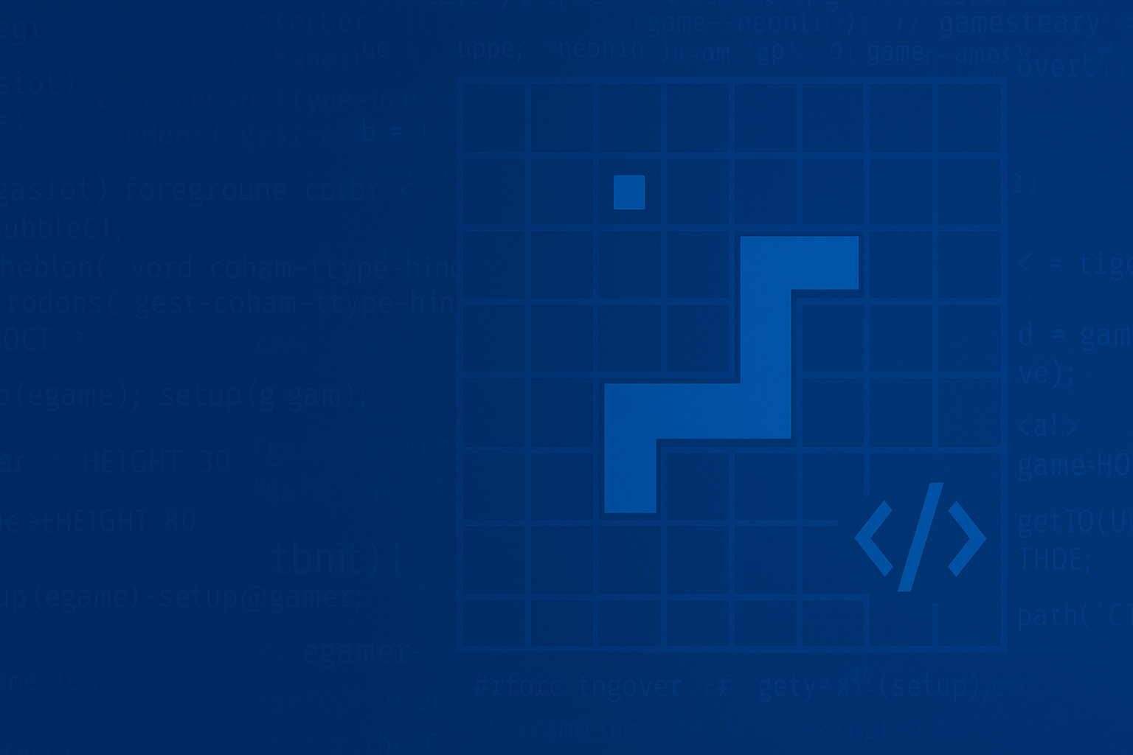


SNAKE GAME
Labib, Raonok, Tahsin, Tanvir, Sorno
SNAKE GAME
GROUP – 4
Course code: CSE115.4
Labib, Raonok, Tahsin, Tanvir, Sorno
GROUP -04
GROUP – 4
Course code: CSE115.4

Slide 2
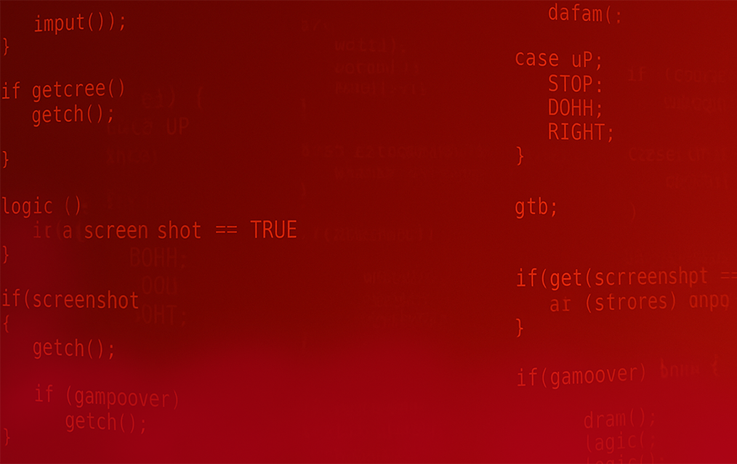



GROUP -04
GROUP – 4
Course code: CSE115.4
SNAKE GAME
GROUP -04
What WE
built
Main
purpose
Labib, Raonok, Tahsin, Tanvir, Sorno
Project Overview
Mehebub Hassan Sorno – 2523427642
Farhan Haque Labib – 2524053642
Tahsin Rahman – 2523961642
Raonok Matabber – 2523862642
Md Tanvir Hossain Sisir – 2522060642
Tech
stack

Slide 3


What WE
built
Project Overview
Main
purpose
Tech
stack
Labib, Raonok, Tahsin, Tanvir, Sorno

Slide 4
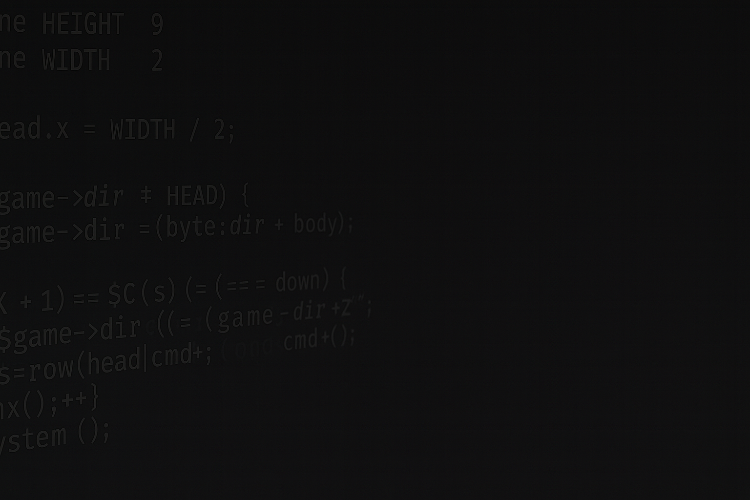
Project Overview
Real-time movement of the snake.
Random food spawning and scoring.
Snake growth mechanics with each food eaten.
Self-collision detection and game-over conditions.
Power-ups (e.g., speed boost, bonus points).
Persistent high-score storage (data saved to a file).
What WE
built
Labib, Raonok, Tahsin, Tanvir, Sorno
Main
purpose
To apply C programming concepts in a functional, interactive project.
To practice modular programming by splitting logic into separate reusable functions.
To implement file handling for saving scores and loading data.
To gain team collaboration experience using GitHub and version control.
Main
purpose
Tech
stack

Slide 5
Real-time movement of the snake.
Random food spawning and scoring.
Snake growth mechanics with each food eaten.
Self-collision detection and game-over conditions.
Power-ups (e.g., speed boost, bonus points).
Persistent high-score storage (data saved to a file).
Project Overview
To apply C programming concepts in a functional, interactive project.
To practice modular programming by splitting logic into separate reusable functions.
To implement file handling for saving scores and loading data.
To gain team collaboration experience using GitHub and version control.
What WE
built
Main
purpose
Labib, Raonok, Tahsin, Tanvir, Sorno
Programming Approach: Modular programming with separate header (.h) and source (.c) files.
File Handling: For reading/writing high scores.
Randomization: rand() function for food placement.
Console Functions: System calls for rendering & clearing the screen.
Version Control: GitHub for code tracking, commits, and collaboration.
Tech
stack

Slide 6
key
To apply C programming concepts in a functional, interactive project.
To practice modular programming by splitting logic into separate reusable functions.
To implement file handling for saving scores and loading data.
To gain team collaboration experience using GitHub and version control.
features
Project Overview
Programming Approach: Modular programming with separate header (.h) and source (.c) files.
File Handling: For reading/writing high scores.
Randomization: rand() function for food placement.
Console Functions: System calls for rendering & clearing the screen.
Version Control: GitHub for code tracking, commits, and collaboration.
What WE
built
Main
purpose
Tech
stack
Labib, Raonok, Tahsin, Tanvir, Sorno

Slide 7
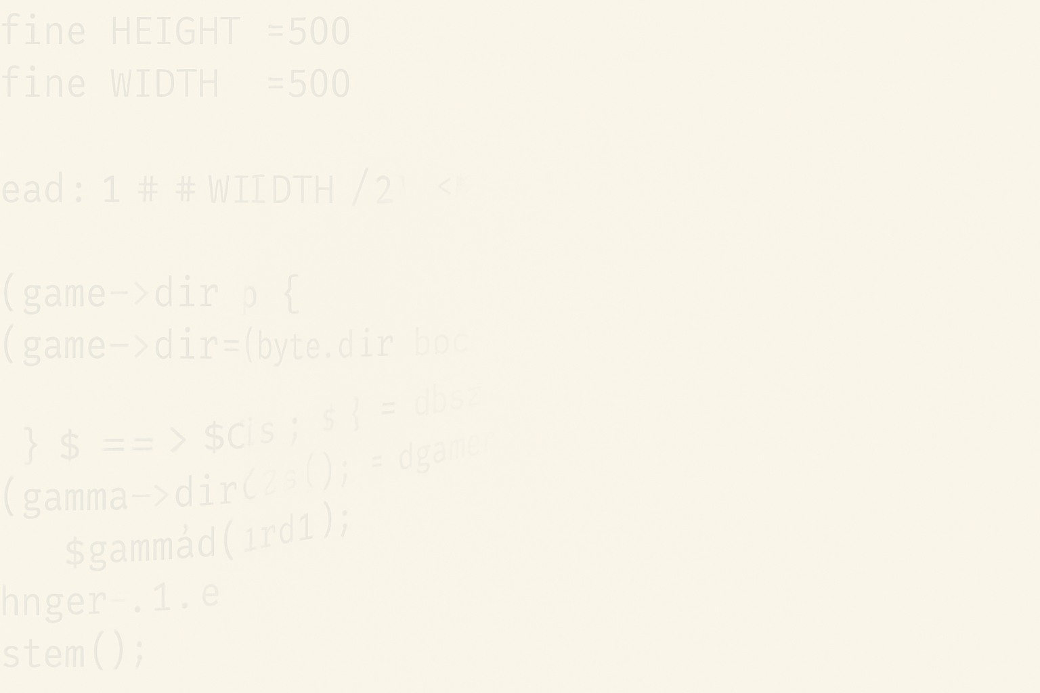


To apply C programming concepts in a functional, interactive project.
To practice modular programming by splitting logic into separate reusable functions.
To implement file handling for saving scores and loading data.
To gain team collaboration experience using GitHub and version control.
Project Overview
Programming Approach: Modular programming with separate header (.h) and source (.c) files.
File Handling: For reading/writing high scores.
Randomization: rand() function for food placement.
Console Functions: System calls for rendering & clearing the screen.
Version Control: GitHub for code tracking, commits, and collaboration.
key
features
key
What WE
built
features
Main
purpose
Tech
stack
Labib, Raonok, Tahsin, Tanvir, Sorno
Grid-based movement;
grows +1 segment per food.

Slide 8
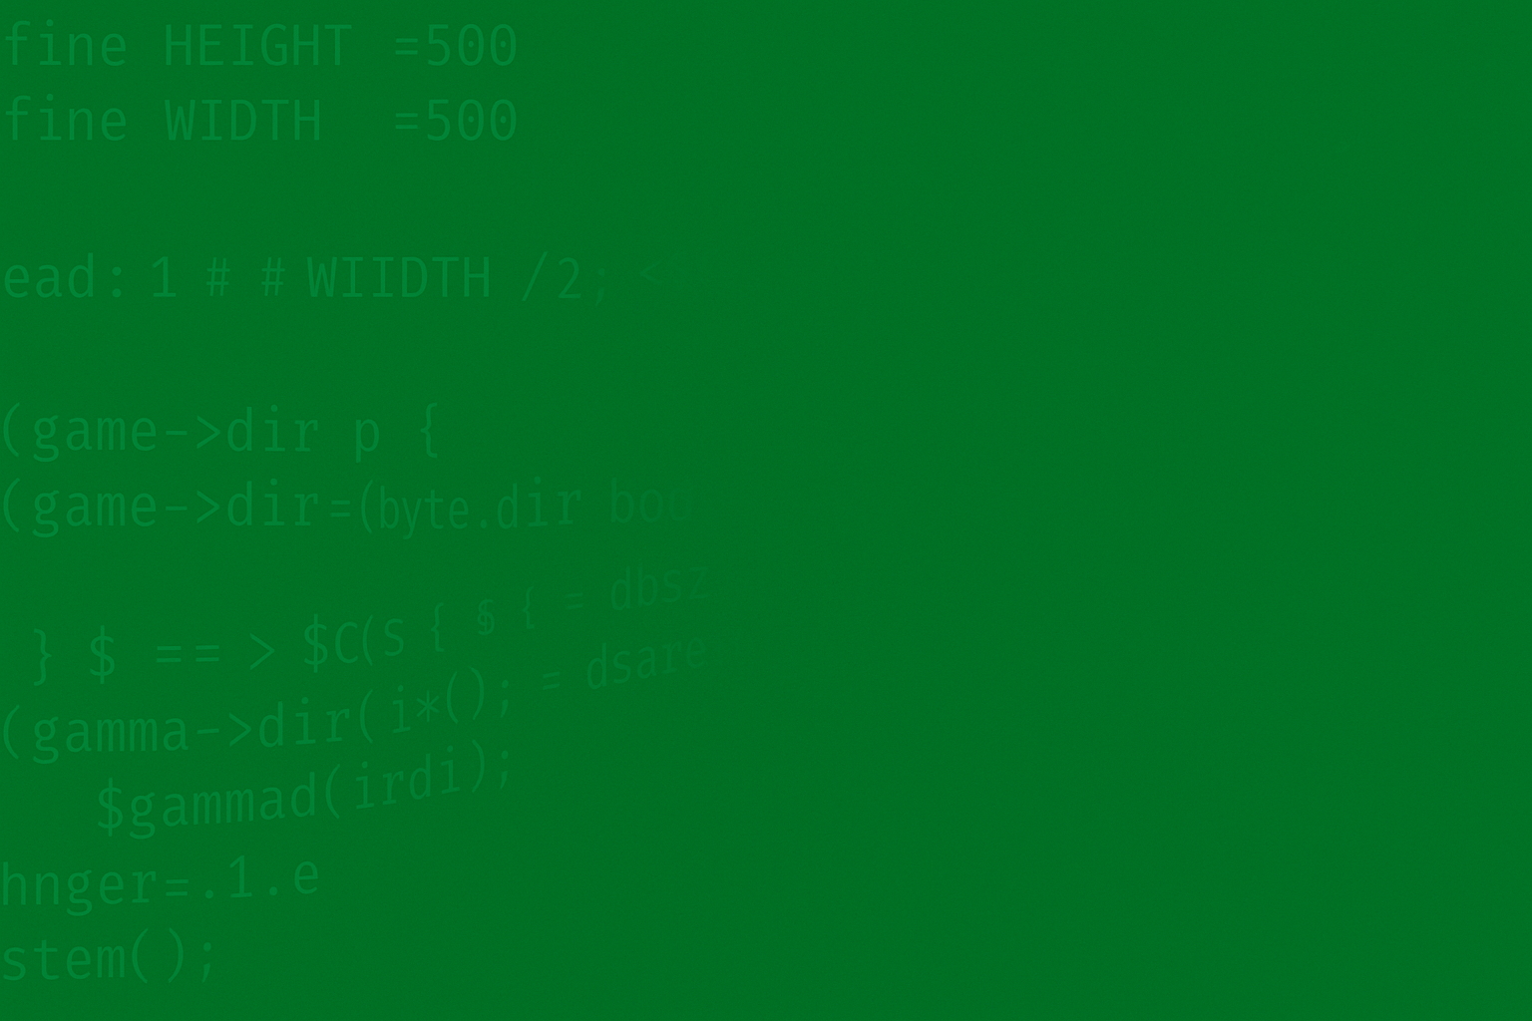
key
features
Movement & Growth
Grid-based movement;
grows +1 segment per food.
Labib, Raonok, Tahsin, Tanvir, Sorno
Food Spawning
Random, never on snake;
Re-rolls until an empty cell.

Slide 9
Grid-based movement;
grows +1 segment per food.
key
features
Movement & Growth
Food Spawning
Random, never on snake;
Re-rolls until an empty cell.
Labib, Raonok, Tahsin, Tanvir, Sorno
Collision Detection
Instant game-over on wall/self hit

Slide 10
Random, never on snake;
Re-rolls until an empty cell.
key
features
Movement & Growth
Food Spawning
Collision Detection
Instant game-over on wall/self hit
Labib, Raonok, Tahsin, Tanvir, Sorno
Power-Ups
Occasional spawn; temporary speed up/down.

Slide 11
Instant game-over on wall/self hit
key
features
Movement & Growth
Food Spawning
Collision Detection
Power-Ups
Occasional spawn; temporary speed up/down.
Labib, Raonok, Tahsin, Tanvir, Sorno
High score persisted
via file I/O
Score Saving

Slide 12


Occasional spawn; temporary speed up/down.
key
features
Movement & Growth
Food Spawning
Collision Detection
Power-Ups
Score Saving
High score persisted
via file I/O
Labib, Raonok, Tahsin, Tanvir, Sorno
Architecture

Slide 13



Occasional spawn; temporary speed up/down.
key
features
Movement & Growth
Food Spawning
Collision Detection
High score persisted
via file I/O
Power-Ups
Labib, Raonok, Tahsin, Tanvir, Sorno
Score Saving
Core structs & high score handling
Drawing & rendering
Setup & input handling
Game logic
Main loop & integration

Slide 14
Core structs & high score handling
Setup & input handling
Drawing & rendering
Main loop & integration
Game logic
Labib, Raonok, Tahsin, Tanvir, Sorno

Slide 15
Core structs & high score handling
#include <stdio.h>
#include <stdlib.h>
#include <conio.h>
#include <windows.h>
#include <time.h>
Setup & input handling
Game logic
Drawing & rendering
Main loop & integration
headers
Game constants
Labib, Raonok, Tahsin, Tanvir, Sorno

Slide 16
Core structs & high score handling
#define WIDTH 40
#define HEIGHT 20
#define MAX_LENGTH 100
#define INITIAL_SPEED 200
Setup & input handling
Game logic
Drawing & rendering
Main loop & integration
headers
Game constants
Direction enum
Labib, Raonok, Tahsin, Tanvir, Sorno

Slide 17
Core structs & high score handling
typedef enum { UP, DOWN, LEFT, RIGHT } Direction;
Setup & input handling
Game logic
Drawing & rendering
Main loop & integration
Core data structures
Direction enum
Game constants
Labib, Raonok, Tahsin, Tanvir, Sorno

Slide 18
Core structs & high score handling
struct Point { int x, y; };
Setup & input handling
Game logic
Drawing & rendering
Main loop & integration
Core data structures
Direction enum
Labib, Raonok, Tahsin, Tanvir, Sorno

Slide 19
Core structs & high score handling
struct Snake
{
struct Point body[MAX_LENGTH];
// positions of all segments
int length;
// current number of segments
Direction dir;
// current movement direction
};
Setup & input handling
Game logic
Drawing & rendering
Global game state
Main loop & integration
Core data structures
Labib, Raonok, Tahsin, Tanvir, Sorno

Slide 20
Core structs & high score handling
struct Snake snake;
// the one snake
struct Point food, powerup;
// positions of food and power-up
int score = 0, highscore = 0;
// scoring
int game_over = 0;
// loop control flag
int speed = INITIAL_SPEED;
// ms delay per frame, can change
int powerup_timer = 0;
// frames remaining for a power-up effect
Setup & input handling
Game logic
Drawing & rendering
High-score I/O
Main loop & integration
Global game state
Core data structures
Labib, Raonok, Tahsin, Tanvir, Sorno

Slide 21
Core structs & high score handling
void load_highscore()
{
FILE *file = fopen("Highscore.txt", "r");
if (file != NULL){
fscanf(file, "%d", &highscore);
fclose(file);
} else {
printf("There was an error opening the file.");
return;
}
}
Setup & input handling
Game logic
Drawing & rendering
Main loop & integration
High-score I/O
Global game state
Labib, Raonok, Tahsin, Tanvir, Sorno

Slide 22
Core structs & high score handling
void save_highscore()
{
FILE *file = fopen("Highscore.txt", "w");
if (file != NULL){
fprintf(file, "%d", highscore);
fclose(file);
} else {
printf("There was an error opening the file.");
return;
}
}
Setup & input handling
Game logic
Drawing & rendering
Main loop & integration
High-score I/O
Clear the Screen
Global game state
Labib, Raonok, Tahsin, Tanvir, Sorno

Slide 23
Core structs & high score handling
void hideCursor()
{
HANDLE consoleHandle = GetStdHandle(STD_OUTPUT_HANDLE); CONSOLE_CURSOR_INFO cursorInfo; GetConsoleCursorInfo(consoleHandle, &cursorInfo);
cursorInfo.bVisible = FALSE; SetConsoleCursorInfo(consoleHandle, &cursorInfo);
}
void clearScreen()
{
COORD coord = {0, 0}; SetConsoleCursorPosition(GetStdHandle(STD_OUTPUT_HANDLE), coord);
}
Setup & input handling
Game logic
Drawing & rendering
High-score I/O
Main loop & integration
Clear the Screen
Labib, Raonok, Tahsin, Tanvir, Sorno

Slide 24
Core structs & high score handling
Setup & input handling
snake.length = 3;
snake.body[0].x = WIDTH / 2;
snake.body[0].y = HEIGHT / 2;
snake.dir = RIGHT;
Game logic
Drawing & rendering
Set Initial Body Positions
Initialize Snake Properties
Main loop & integration
Clear the Screen
Labib, Raonok, Tahsin, Tanvir, Sorno

Slide 25
Core structs & high score handling
Setup & input handling
for(int i = 1; i < snake.length; i++)
{
snake.body[i].x = snake.body[0].x-i;
snake.body[i].y = snake.body[0].y;
}
Game logic
Drawing & rendering
Main loop & integration
Set Initial Body Positions
Spawn Food and Power-up Randomly
Initialize Snake Properties
Labib, Raonok, Tahsin, Tanvir, Sorno

Slide 26
Core structs & high score handling
Setup & input handling
food.x = rand() % WIDTH;
food.y = rand() % HEIGHT;
powerup.x = rand() % WIDTH;
powerup.y = rand() % HEIGHT;
Game logic
Drawing & rendering
Main loop & integration
Load Saved High Score
Spawn Food and Power-up Randomly
Set Initial Body Positions
Spawn Food and Power-up Randomly
Labib, Raonok, Tahsin, Tanvir, Sorno

Slide 27
Core structs & high score handling
Setup & input handling
load_highscore();
Game logic
Drawing & rendering
Main loop & integration
Load Saved High Score
Spawn Food and Power-up Randomly
Check if a Key was Pressed
Labib, Raonok, Tahsin, Tanvir, Sorno

Slide 28
Core structs & high score handling
Setup & input handling
if(_kbhit()){
Game logic
Drawing & rendering
Check if a Key was Pressed
Main loop & integration
Load Saved High Score
Read the Key
Labib, Raonok, Tahsin, Tanvir, Sorno

Slide 29
Core structs & high score handling
Setup & input handling
char key = _getch();
Game logic
Drawing & rendering
Read the Key
Main loop & integration
Change Snake Direction Based on Input
Change Snake Direction Based on Input
Check if a Key was Pressed
Labib, Raonok, Tahsin, Tanvir, Sorno

Slide 30
Core structs & high score handling
Setup & input handling
switch(key)
{
case 'w':
case 'W':
if(snake.dir != DOWN) snake.dir = UP;
break;
...
}
Game logic
Drawing & rendering
Read the Key
Move the Head One Cell (based on direction)
Main loop & integration
Change Snake Direction Based on Input
Change Snake Direction Based on Input
Labib, Raonok, Tahsin, Tanvir, Sorno

Slide 31
Core structs & high score handling
Setup & input handling
Game logic
switch (snake.dir)
{
case UP: snake.body[0].y--; break;
case LEFT: snake.body[0].x--; break;
case RIGHT: snake.body[0].x++; break;
case DOWN: snake.body[0].y++; break;
}
Drawing & rendering
Main loop & integration
Change Snake Direction Based on Input
Move the Head One Cell (based on direction)
Make the Body Follow the Head
Labib, Raonok, Tahsin, Tanvir, Sorno

Slide 32
Core structs & high score handling
Setup & input handling
Game logic
struct Point prev = snake.body[0], temp;
for (int i = 1; i < snake.length; i++)
{
temp = snake.body[i];
snake.body[i] = prev;
// each segment moves to the previous segment's old spot
prev = temp;
}
Drawing & rendering
Main loop & integration
Make the Body Follow the Head
Move the Head One Cell (based on direction)
Check Wall Collision
Labib, Raonok, Tahsin, Tanvir, Sorno

Slide 33
Core structs & high score handling
Setup & input handling
Game logic
if (snake.body[0].x <= 0 || snake.body[0].x >= WIDTH ||
snake.body[0].y <= 0 || snake.body[0].y >= HEIGHT)
{
game_over = 1; return;
}
Drawing & rendering
Main loop & integration
Check Wall Collision
Check Self-Collision
Make the Body Follow the Head
Labib, Raonok, Tahsin, Tanvir, Sorno

Slide 34
Core structs & high score handling
Setup & input handling
Game logic
for (int i = 1; i < snake.length; i++)
{
if (snake.body[0].x == snake.body[i].x &&
snake.body[0].y == snake.body[i].y) {
game_over = 1; return;
}
}`
Drawing & rendering
Main loop & integration
Handle Eating Food
(grow + score + respawn + speed-up)
Check Wall Collision
Check Self-Collision
Labib, Raonok, Tahsin, Tanvir, Sorno

Slide 35
Core structs & high score handling
Setup & input handling
Game logic
if (snake.body[0].x == food.x && snake.body[0].y == food.y) {
score += 10;
snake.length++;
if (snake.length < MAX_LENGTH) {
snake.body[snake.length-1] = snake.body[snake.length-2];
}
food.x = rand() % (WIDTH - 2) + 1;
food.y = rand() % (HEIGHT - 2) + 1;
if (speed > 50) speed -= 5;
}
Drawing & rendering
Main loop & integration
Handle Eating Food
(grow + score + respawn + speed-up)
Handle Power-Ups
(speed change + respawn + timer)
Check Self-Collision
Labib, Raonok, Tahsin, Tanvir, Sorno

Slide 36
Core structs & high score handling
Setup & input handling
Game logic
if (snake.body[0].x == powerup.x && snake.body[0].y == powerup.y) {
int type = rand() % 2;
if (type == 0) speed -= 20; // speed up
else speed += 20; // slow down
powerup_timer = 30;
powerup.x = rand() % (WIDTH - 2) + 1;
powerup.y = rand() % (HEIGHT - 2) + 1;
if (powerup_timer > 0) powerup_timer--;
}
Drawing & rendering
Main loop & integration
Handle Eating Food
(grow + score + respawn + speed-up)
Handle Power-Ups
(speed change + respawn + timer)
Clear the Screen
Labib, Raonok, Tahsin, Tanvir, Sorno

Slide 37
Core structs & high score handling
Setup & input handling
system("cls");
Game logic
Drawing & rendering
Main loop & integration
Clear the Screen
Handle Power-Ups
(speed change + respawn + timer)
Loop Through Every Cell in the Grid
Labib, Raonok, Tahsin, Tanvir, Sorno

Slide 38
Core structs & high score handling
Setup & input handling
for (int y = 0; y <= HEIGHT; y++) {
for (int x = 0; x <= WIDTH; x++) {
...
}
printf("\n");
}
Game logic
Drawing & rendering
Main loop & integration
Draw Walls
Loop Through Every Cell in the Grid
Clear the Screen
Labib, Raonok, Tahsin, Tanvir, Sorno

Slide 39
Core structs & high score handling
Setup & input handling
if (x == 0 || x == WIDTH || y == 0 || y == HEIGHT) {
printf("#");
}
Game logic
Drawing & rendering
Main loop & integration
Draw Food
Draw Walls
Loop Through Every Cell in the Grid
Labib, Raonok, Tahsin, Tanvir, Sorno

Slide 40
Core structs & high score handling
Setup & input handling
else if (x == food.x && y == food.y) {
printf("F");
}
Game logic
Drawing & rendering
Main loop & integration
Draw Food
Draw Walls
Draw Power-Up
Labib, Raonok, Tahsin, Tanvir, Sorno

Slide 41
Core structs & high score handling
Setup & input handling
else if (x == powerup.x && y == powerup.y) {
printf("P");
}
Game logic
Drawing & rendering
Main loop & integration
Draw Power-Up
Draw Food
Draw Snake
Labib, Raonok, Tahsin, Tanvir, Sorno

Slide 42
Core structs & high score handling
Setup & input handling
else {
int is_snake = 0;
for (int i = 0; i < snake.length; i++) {
if (snake.body[i].x == x && snake.body[i].y == y) {
if (i == 0) printf("O"); // Snake head
else printf("o"); // Snake body
is_snake = 1;
break;
}
}
if (is_snake == 0) {
printf(" ");
}
}
Game logic
Drawing & rendering
Main loop & integration
Draw Power-Up
Draw Snake
Display Score & High Score
Labib, Raonok, Tahsin, Tanvir, Sorno

Slide 43
Core structs & high score handling
Setup & input handling
printf("Score: %d Highscore: %d\n", score, highscore);
Game logic
Drawing & rendering
Main loop & integration
Display Score & High Score
Draw Snake
Seed the Random Number Generator
Labib, Raonok, Tahsin, Tanvir, Sorno

Slide 44
Core structs & high score handling
Setup & input handling
srand(time(NULL));
Game logic
Drawing & rendering
Main loop & integration
Initialize the Game State
Display Score & High Score
Seed the Random Number Generator
Labib, Raonok, Tahsin, Tanvir, Sorno

Slide 45
Core structs & high score handling
Setup & input handling
setup();
Game logic
Drawing & rendering
Main loop & integration
Initialize the Game State
Seed the Random Number Generator
The Main Game Loop
Labib, Raonok, Tahsin, Tanvir, Sorno

Slide 46
Core structs & high score handling
Setup & input handling
while (game_over == 0)
{
draw();
input();
logic();
Sleep(speed);
}
Game logic
Drawing & rendering
Main loop & integration
Initialize the Game State
The Main Game Loop
Update High Score
Labib, Raonok, Tahsin, Tanvir, Sorno

Slide 47
Core structs & high score handling
Setup & input handling
if (score > highscore)
{
highscore = score;
save_highscore();
}
Game logic
Drawing & rendering
Main loop & integration
Update High Score
The Main Game Loop
Display Game Over Screen
Labib, Raonok, Tahsin, Tanvir, Sorno

Slide 48
Core structs & high score handling
Setup & input handling
printf("\nGame Over! Final Score: %d\n", score);
printf("Press any key to exit...\n");
_getch();
Game logic
Drawing & rendering
Main loop & integration
Exit Program
Display Game Over Screen
Update High Score
Labib, Raonok, Tahsin, Tanvir, Sorno

Slide 49
Core structs & high score handling
Setup & input handling
return 0;
Game logic
Drawing & rendering
Main loop & integration
Display Game Over Screen
Exit Program
Labib, Raonok, Tahsin, Tanvir, Sorno

Slide 50

Setup & input handling
return 0;
Game logic
Drawing & rendering
Exit Program
Core structs & high score handling
SYSTEM
Architecture
Display Game Over Screen
Main loop & integration
&
Challenges
Solutions
Labib, Raonok, Tahsin, Tanvir, Sorno
Adjusted movement logic & reduced frame delay

Slide 51
&
Challenges
Solutions
Snake movement glitches at high speed
Adjusted movement logic & reduced frame delay
Labib, Raonok, Tahsin, Tanvir, Sorno
Added spawn validation check

Slide 52
&
Challenges
Solutions
Snake movement glitches at high speed
Random food spawning on snake body
Added spawn validation check
Labib, Raonok, Tahsin, Tanvir, Sorno
Fixed file handling and save trigger
Adjusted movement logic & reduced frame delay

Slide 53
Answer
AND
&
Challenges
Solutions
Snake movement glitches at high speed
Random food spawning on snake body
High score not saving correctly
QUESTION
Fixed file handling and save trigger
Labib, Raonok, Tahsin, Tanvir, Sorno
Fixed file handling and save trigger

Slide 54
AND
Challenges
Solutions
Random food spawning on snake body
Fixed file handling and save trigger
High score not saving correctly
Fixed file handling and save trigger
Snake movement glitches at high speed
Thank
you
QUESTION
Answer
AND
Labib, Raonok, Tahsin, Tanvir, Sorno

Slide 55

Labib, Raonok, Tahsin, Tanvir, Sorno
QUESTION
Thank
you
AND
Answer

